Slide 1
Binary Search Tree

Slide 2
Binary Search
Fast way to search for elements in a sorted array
Looping through elements one by one is slow [O(N)]
Idea:
Jump to the middle element:
if the middle is what we're looking for, we're done. Hooray!
if the middle is too small (we didn't go far enough) – we rule out the entire left side of elements smaller than the middle element
if the middle is too big(we went too far) – we rule out the entire
right side of elements bigger than the middle element
0 1 2 3 4 5 6 7 8 9 10
2 | 5 | 6 | 8 | 11 | 13 | 17 | 22 | 23 | 29 | 31

Slide 3
Binary Search in Action
Search for 8:
0 1 2 3 4 5 6 7 8 9 10
2 | 5 | 6 | 8 | 11 | 13 | 17 | 22 | 23 | 29 | 31

Slide 4
Binary Search in Action
Search for 8:
middle
0 1 2 3 4 5 6 7 8 9 10
2 | 5 | 6 | 8 | 11 | 13 | 17 | 22 | 23 | 29 | 31

Slide 5
Binary Search in Action
Search for 8:
Look at 13
– it's too big, so we rule out indices 5-10
middle
0 1 2 3 4 5 6 7 8 9 10
2 | 5 | 6 | 8 | 11 | 13 | 17 | 22 | 23 | 29 | 31

Slide 7
Binary Search in Action
Search for 8:
Look at 13
– it's too big, so we rule out indices 5-10
Pick the new middle of the remaining elements
Look at 6:
middle
0 1 2 3 4 5 6 7 8 9 10
2 | 5 | 6 | 8 | 11 | 13 | 17 | 22 | 23 | 29 | 31

Slide 8
Binary Search in Action
Search for 8:
Look at 13
it's too big, so we rule out indices 5-10
Pick the new middle of the remaining elements
Look at 6:
it's too small, so we rule out indices 0-3
middle
0 1 2 3 4 5 6 7 8 9 10
2 | 5 | 6 | 8 | 11 | 13 | 17 | 22 | 23 | 29 | 31

Slide 9
Binary Search in Action
Search for 8:
Look at 13
it's too big, so we rule out indices 5-10
Pick the new middle of the remaining elements
Look at 6:
it's too small, so we rule out indices 0-3
Look at 8:
it's just right! We return true
middle
0 1 2 3 4 5 6 7 8 9 10
2 | 5 | 6 | 8 | 11 | 13 | 17 | 22 | 23 | 29 | 31

Slide 10
Binary Search in Action
Search for 7:
middle
0 1 2 3 4 5 6 7 8 9 10
2 | 5 | 6 | 8 | 11 | 13 | 17 | 22 | 23 | 29 | 31

Slide 11
Binary Search in Action
Search for 7:
Look at 13
– it's too big, so we rule out indices 5-10
middle
0 1 2 3 4 5 6 7 8 9 10
2 | 5 | 6 | 8 | 11 | 13 | 17 | 22 | 23 | 29 | 31

Slide 12
Binary Search in Action
Search for 7:
Look at 13
– it's too big, so we rule out indices 5-10
Pick the new middle of the remaining elements
Look at 6:
middle
0 1 2 3 4 5 6 7 8 9 10
2 | 5 | 6 | 8 | 11 | 13 | 17 | 22 | 23 | 29 | 31

Slide 13
Binary Search in Action
Search for 7:
Look at 13
it's too big, so we rule out indices 5-10
Pick the new middle of the remaining elements
Look at 6:
it's too small, so we rule out indices 0-3
middle
0 1 2 3 4 5 6 7 8 9 10
2 | 5 | 6 | 8 | 11 | 13 | 17 | 22 | 23 | 29 | 31

Slide 14
Binary Search in Action
Search for 7:
Look at 13
it's too big, so we rule out indices 5-10
Look at 6:
it's too small, so we rule out indices 0-3
Look at 8:
it's too big! We rule out elements 3-4
middle
0 1 2 3 4 5 6 7 8 9 10
2 | 5 | 6 | 8 | 11 | 13 | 17 | 22 | 23 | 29 | 31

Slide 15
Binary Search in Action
Search for 7:
Look at 13
it's too big, so we rule out indices 5-10
Look at 6:
it's too small, so we rule out indices 0-3
Look at 8:
it's too big! We rule out elements 3-4
No elements left to search – we return false
middle
0 1 2 3 4 5 6 7 8 9 10
2 | 5 | 6 | 8 | 11 | 13 | 17 | 22 | 23 | 29 | 31

Slide 16
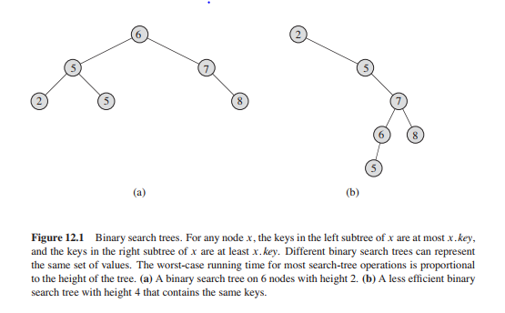
Binary Tree definition
The keys in a binary search tree are always stored in such a way as to satisfy the binary-search-tree property: Let x be a node in a binary search tree. If y is a node in the left subtree of x, then y.key < x.key. If y is a node in the right subtree of x, then y.key >= x.key.

Slide 17
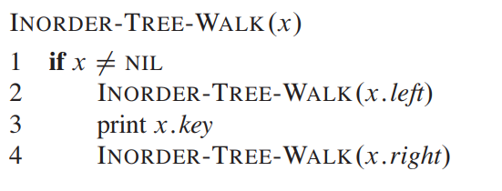
In order tree walk
The binary-search-tree property allows us to print out all the keys in a binary search tree in sorted order by a simple recursive algorithm, called an inorder tree walk.

Slide 18
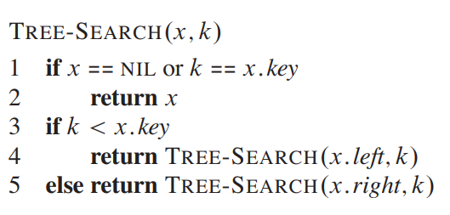
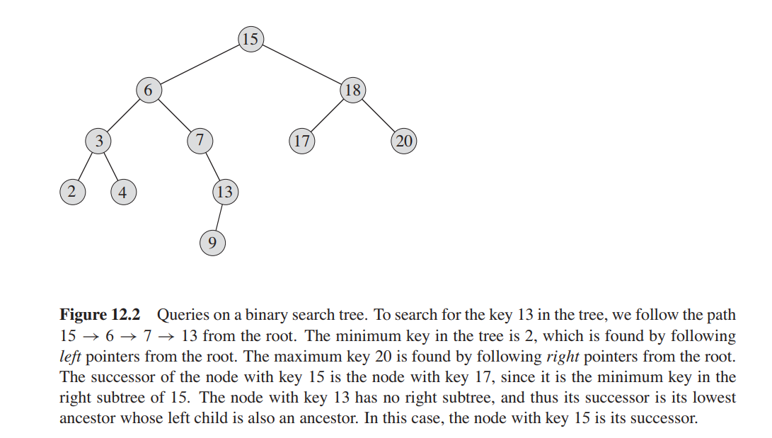
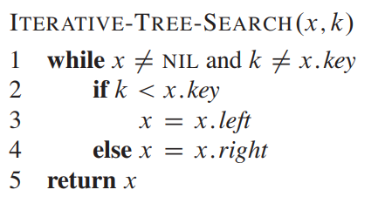
Searching in Binary Search Tree

Slide 19
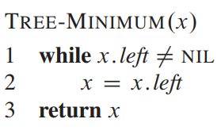
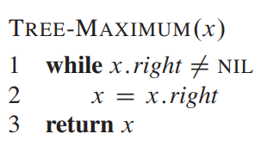
Minimum and maximum in Binary Search Tree

Slide 20
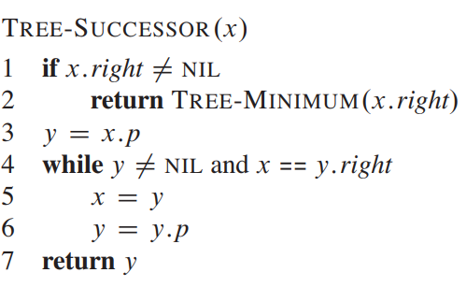
Tree Successor

Slide 21
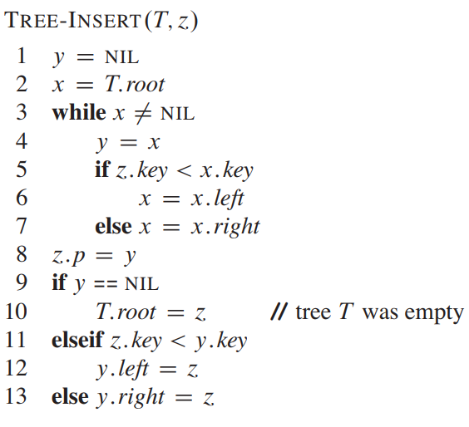
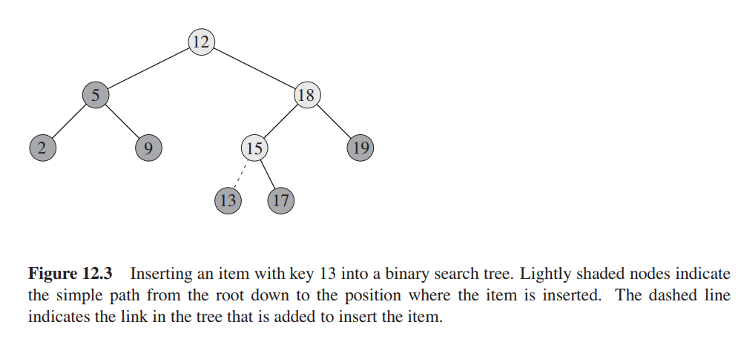
Tree insertion

Slide 22
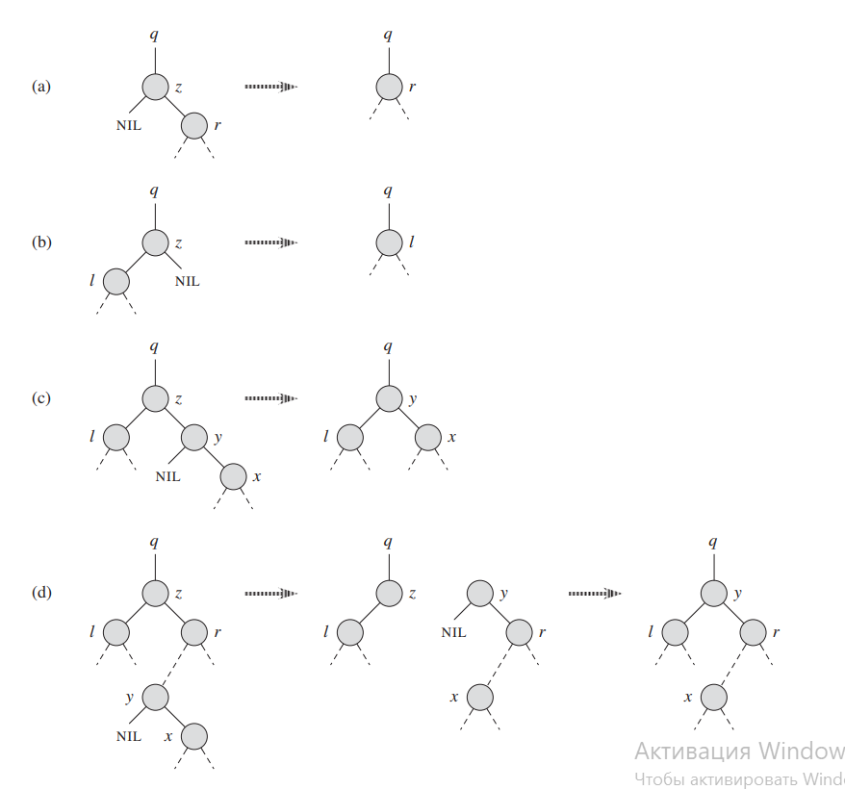
Tree deletion
The overall strategy for deleting a node Z from a binary search tree T has three basic cases but, as we shall see, one of the cases is a bit tricky.
If Z has no children, then we simply remove it by modifying its parent to replace Z with NIL as its child.
If Z has just one child, then we elevate that child to take Z’s position in the tree by modifying Z’s parent to replace Z by Z’s child.
If Z has two children, then we find Z’s successor Y—which must be in Z’s right subtree—and have y take Z’s position in the tree. The rest of Z’s original right subtree becomes Y’s new right subtree, and Z’s left subtree becomes Y’s new left subtree. This case is the tricky one because, as we shall see, it matters whether Y is Z’s right child.

Slide 23
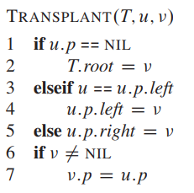
Transplant
In order to move subtrees around within the binary search tree, we define a subroutine TRANSPLANT, which replaces one subtree as a child of its parent with another subtree.

Slide 24
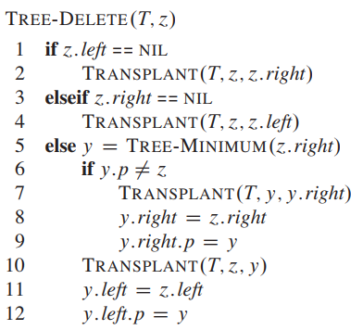
Tree deletion

